Slide 1

Department of Artificial Intelligence and Machine Learning
MINI PROJECT - AI19541
FUNDAMENTALS OF DEEP LEARNING
SALES ANALYSIS
PROJECT BY, LALITH ASWIN KUMAR B (221501064)
LOKESHWARAN V (221501067)
JAI NIKKIL 22 (221501064)
.
1

Slide 2
OUTLINE
Objectives
Abstract
Introduction
Problem statement
Existing system
Limitations of existing system
Proposed system
Architecture diagram
Overall Architectural design
Techniques Used
Module implementation
Results
Conclusion

Slide 3
OBJECTIVE
The objective of this project is to develop a deep learning model capable of accurately forecasting future sales based on historical data, seasonal trends, and external factors. By leveraging advanced algorithms like LSTMs or Transformer networks, the model aims to provide actionable insights to optimize inventory levels, improve demand forecasting, and support data-driven decision-making in pricing and marketing strategies. The objective of this deep learning project is to build an advanced sales prediction model that leverages historical sales data, seasonal trends, and external economic or market factors to accurately forecast future sales. Using deep learning algorithms such as Long Short-Term Memory (LSTM) networks and Transformer models, this project aims to provide a powerful predictive tool that will support businesses in making informed, data-driven decisions to optimize operational and strategic outcomes. Specifically, the model will focus on capturing complex, non-linear relationships within sales data, as well as identifying temporal patterns and dependencies that are challenging to detect with traditional statistical models. By forecasting future sales with high accuracy, the project seeks to improve inventory planning, reduce stockouts and overstock situations, and enhance customer satisfaction through better demand fulfillment. Furthermore, the model’s insights into seasonal and trend-based demand fluctuations will empower marketing teams to design targeted campaigns, optimize product pricing, and allocate resources effectively. In addition to business benefits, this project will explore the potential for using external data sources, such as economic indicators, holiday seasons, and weather patterns, to increase forecast reliability.

Slide 4
ABSTRACT
This project presents a comprehensive machine learning system designed to predict the sales of an international chain of retail stores. The system aggregates daily sales data from each store in the chain, providing a detailed historical sales record. It also offers granular insights into individual store performance, including daily sales figures and identifying the top-selling products. Additionally, the system captures customer information, enabling the generation of personalized customer profiles. These profiles help store management understand customer preferences and behaviors, facilitating targeted marketing and personalized service. The predictive model employs advanced machine learning algorithms to forecast future sales trends, optimizing inventory management and strategic planning. The solution integrates data collection, processing, and analysis into a unified platform, enhancing decision-making capabilities and improving overall operational efficiency.

Slide 5
INTRODUCTION
In today's competitive retail environment, leveraging data to drive business decisions is more critical than ever. This project aims to develop a sophisticated machine learning system to predict sales for an international chain of retail stores. By harnessing the power of data, the system not only forecasts future sales trends but also provides detailed insights into daily sales activities across the entire chain.The system is designed to collect and process daily sales data from each store, building a comprehensive historical record. This enables a deep dive into individual store performance, revealing patterns and trends that might otherwise go unnoticed. By identifying the top-selling products in each store, the system helps optimize inventory management, ensuring that high-demand items are always in stock.Furthermore, the system gathers valuable customer information, allowing for the creation of detailed customer profiles. These profiles empower store management with insights into customer preferences and behaviors, paving the way for personalized marketing strategies and enhanced customer service. The integration of customer data with sales analytics provides a holistic view of the business, supporting more informed decision-making.Through advanced machine learning algorithms, the system predicts future sales with high accuracy, helping to mitigate risks associated with overstocking or understocking. This predictive capability is crucial for maintaining optimal inventory levels, reducing waste, and maximizing profitability.

Slide 6
INTRODUCTION
In essence, this project merges data collection, analysis, and predictive modeling into a seamless solution, delivering actionable insights that drive business growth and efficiency. By transforming raw sales data into strategic intelligence, the system positions the retail chain for sustained success in a dynamic market landscape.

Slide 7
PROBLEM DOMAIN
The international retail chain faces several challenges in optimizing its sales and inventory management processes due to the vast amount of data generated daily across numerous store locations. These challenges include:
Sales Forecasting: The inability to accurately predict future sales trends leads to either overstocking or understocking, resulting in lost sales opportunities and increased holding costs.
Data Consolidation: Aggregating and analyzing daily sales data from all stores is a complex and time-consuming task, hindering timely and effective decision-making.
Individual Store Performance: Lack of detailed insights into the performance of individual stores prevents the identification of specific issues and opportunities at a granular level.
Product Popularity Tracking: Determining which products are the top-sellers in each store is challenging, impacting inventory replenishment and promotional strategies.
Customer Insights: Collecting and utilizing customer information to personalize shopping experiences and marketing efforts is currently insufficient, leading to missed opportunities for enhancing customer loyalty and satisfaction.
To address these challenges, a comprehensive machine learning system is required. This system should predict sales, collect and consolidate daily sales data, provide historical sales insights, track individual store performance, identify top-selling products, and capture detailed customer information to enable personalized customer interactions. The implementation of such a system aims to enhance inventory management, improve sales forecasting accuracy, and support strategic decision-making, ultimately driving overall business growth and efficiency.

Slide 8
EXISTING SYSTEM
Amazon Forecast:
- Overview: Amazon Forecast is a fully managed service that uses machine learning to deliver highly accurate forecasts. It can predict future sales, demand, and business outcomes without requiring expertise in machine learning.
- Key Features: Time-series forecasting, easy integration with existing data sources, automated model selection, and continuous learning from new data.
Microsoft Dynamics 365 Retail:
- Overview: This is a comprehensive retail management solution that offers end-to-end capabilities for managing sales, inventory, and customer relationships.
- Key Features: Sales forecasting, inventory optimization, real-time data analytics, personalized customer experiences, and detailed performance reporting for individual stores.
SAP Customer Activity Repository (CAR):
- Overview: SAP CAR is a central repository that consolidates sales data from all channels and provides real-time analytics and insights.
- Key Features: Unified sales data, demand forecasting, inventory management, customer insights, and detailed reporting on sales and product performance.

Slide 9
LIMITATIONS OF EXISTING SYSTEM
Oracle Retail Demand Forecasting (RDF):
- Overview: Oracle RDF uses advanced analytics and machine learning to predict consumer demand and optimize inventory levels.
- Key Features: Accurate demand forecasting, integration with Oracle Retail suite, real-time data processing, and granular insights into product and store performance.
Salesforce Einstein Analytics:
- Overview: Salesforce Einstein Analytics offers AI-powered insights and predictive analytics for retail businesses, helping them understand customer behavior and forecast sales.
- Key Features: Predictive analytics, customer behavior insights, sales forecasting, personalized marketing, and integration with Salesforce CRM.
Google Cloud Retail AI:
- Overview: Google Cloud Retail AI provides a suite of machine learning tools specifically designed for the retail industry, including recommendations, demand forecasting, and customer insights.
- Key Features: AI-powered demand forecasting, personalized recommendations, customer sentiment analysis, and integration with other Google Cloud services.
These systems exemplify how advanced machine learning and data analytics can be leveraged to predict sales, optimize inventory, and enhance customer experiences in a retail environment. Implementing a similar system tailored to the specific needs of an international retail chain can significantly improve operational efficiency and drive business growth.

Slide 10
PROPOSED SYSTEM
To address the challenges faced by the international retail chain, we propose a comprehensive machine learning system designed to predict sales that uses GENERATIVE ADVERSARIAL NETWORK, collect and consolidate sales data, provide historical insights, and generate personalized customer profiles. The system comprises several integrated components, each serving a specific function to enhance the overall efficiency and effectiveness of the retail operations.
Data Collection Module:
- Functionality: This module collects daily sales data from all stores in the chain, including transaction details, product information, and customer interactions.
- Technology: Uses APIs and ETL (Extract, Transform, Load) processes to aggregate data from various sources into a centralized database.
Data Processing and Storage Module:
- Functionality: Cleans, processes, and stores the collected data in a scalable data warehouse.
- Technology: Utilizes cloud-based data storage solutions such as Amazon Redshift, Google BigQuery, or Azure SQL Data Warehouse to handle large volumes of data efficiently.
Sales Prediction Module:
- Functionality: Predicts future sales trends using machine learning algorithms.
- Technology: Implements advanced time-series forecasting models like ARIMA, Prophet, and LSTM neural networks. The module continuously learns from new data to improve prediction accuracy.
6

Slide 11
PROPOSED SYSTEM
Store Performance Analysis Module
- Functionality: Provides detailed insights into the performance of individual stores, including daily sales figures and top-selling products.
- Technology: Employs data visualization tools such as Tableau or Power BI to create intuitive dashboards and reports for store managers.
Product Popularity Tracking Module
- Functionality: Identifies and tracks the best-selling products in each store to inform inventory management and promotional strategies.
- Technology: Uses clustering and association rule mining algorithms to detect patterns and trends in product sales.
Customer Insights Module
- Functionality: Captures and analyzes customer information to generate personalized profiles and preferences.
- Technology: Leverages customer data platforms (CDPs) and CRM systems integrated with machine learning models to segment customers and predict behavior.
Personalized Marketing and Recommendations Module
- Functionality: Provides personalized marketing suggestions and product recommendations to store management based on customer profiles and purchase history.
- Technology: Utilizes collaborative filtering, content-based filtering, and hybrid recommendation systems to tailor marketing efforts.
Integration and Deployment
- Functionality: Ensures seamless integration of all modules into a unified system, with user-friendly interfaces for store managers and central office staff.
- Technology: Uses microservices architecture with RESTful APIs to enable modular development and easy integration. Deployed on a cloud platform for scalability and reliability.
6

Slide 12
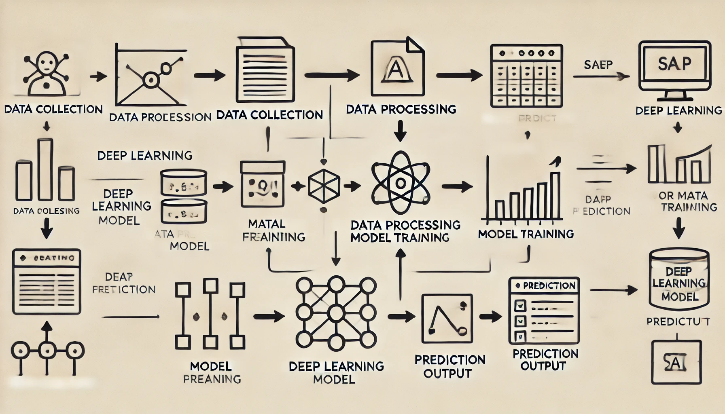
ARCHITECTURE DIAGRAM
6

Slide 13
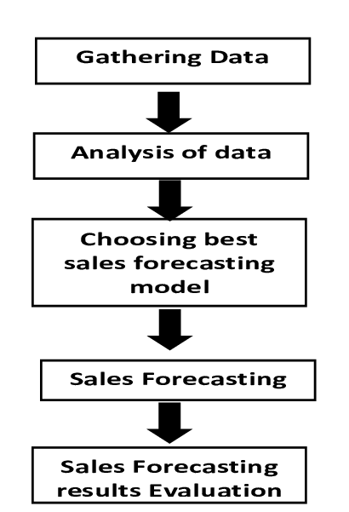
OVERALL ARCHITECTURE DIAGRAM
6

Slide 14
MODULE DESCRIPTION
User Authentication Module: This module manages user authentication and authorization, allowing users to create accounts, log in, and access personalized features such as saving favorite restaurants and hotels.
Location Tracking Module: This module utilizes location-based services to track the user's current location and provide real-time information about nearby restaurants and hotels.
Search Module: The search module enables users to search for nearby restaurants and hotels based on various criteria such as cuisine type, price range, ratings, and distance.
Map Integration Module: This module integrates maps into the application, allowing users to view restaurant and hotel locations, along with directions, distance, and estimated travel time from their current location.
Database Management Module: The database management module manages the storage and retrieval of information about restaurants and hotels, including contact details, opening hours, menus, amenities, and user reviews.
Recommendation Engine Module: This module provides personalized recommendations to users based on their preferences, search history, and location, enhancing their overall experience.
User Interface Module: The user interface module is responsible for developing an intuitive and user-friendly interface, incorporating features such as search functionality, maps, and personalized recommendations.
1
1

Slide 15
Conclusion
This project aims to revolutionize the operational efficiency and strategic decision-making of an international retail chain by implementing a robust machine learning system for sales prediction and data analytics. By integrating multiple components—including data collection, storage, processing, machine learning, and customer insights—the proposed system offers a comprehensive solution to the challenges faced by the retail chain. Capturing and analyzing customer data provides a deeper understanding of customer preferences and behaviors, facilitating personalized marketing efforts and improving customer satisfaction. Automated data collection and processing streamline operations, reducing manual effort and enabling quicker, data-driven decision-making. The use of cloud-based technologies ensures that the system can scale with the business and adapt to changing requirements. Overall, the implementation of this system will significantly enhance the retail chain's ability to forecast sales, manage inventory, understand customer behavior, and make informed decisions. By transforming raw data into actionable insights, the system positions the retail chain for sustained growth and competitive advantage in the dynamic retail market.
9

Slide 16
THANK YOU

